Slide 1
Xtended Meridian
AI medical insurance claim evaluator
HackUTD Ripple 2024 Project

Slide 2

Xtended Meridian in a nutshell
XM is an AI-driven smart advisor which substantially reduces the processing time for medical insurance claim evaluation.
XM leverages a cutting-edge sophisticated retrieval technique – Retrieval Augmented Generation (RAG).
XM takes insurance claim evaluation to the next level by incorporating Multi Agentic framework.
Each agent is assigned with a defined task, in this case: 1. Claim Analysis 2. Historical Analysis (deep dive) 3. Policy Validation

Slide 3

Features
Automated claims processing and fraud detection.
Policy verification/validation
Context-aware claim analysis using RAG
Intelligent settlement recommendations
Justifications and reasonableness of claim.

Slide 4
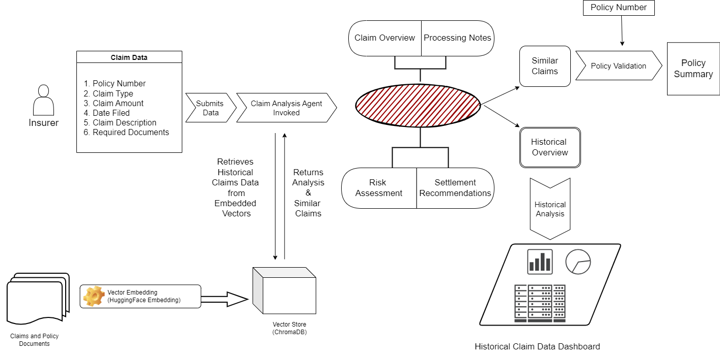
Project Workflow

Slide 5

Challenges Faced
Understanding complex insurance policies
Integrating multiple agents

Slide 6
Proud Accomplishments
Delivered a fully functional prototype
Achieved high
Designed an intuitive and interactive user interface

Slide 7
Future of the Project
Integration with real-time data sources and APIs
Stronger security measures and audit trails
Potential for global insurance industry adoption
Enhanced Agent-Agent communication
Addition of more Agents for personalized features

